Slide 1
Why is Higher Ed So Expensive?

Slide 2
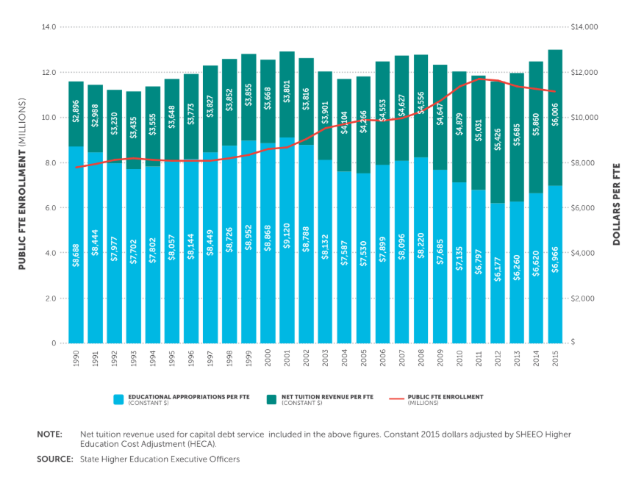

Slide 3
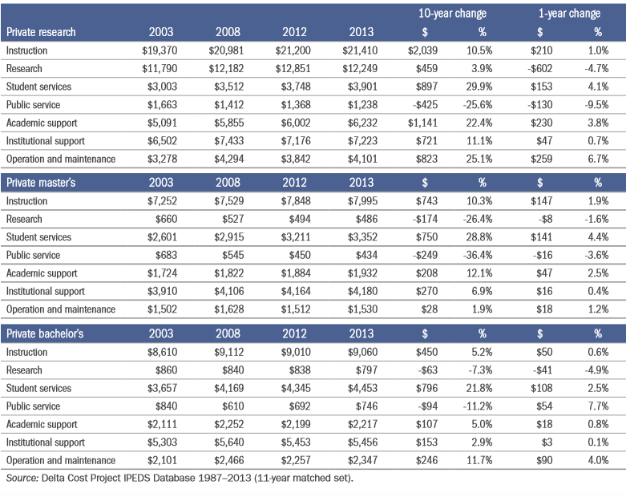

Slide 4
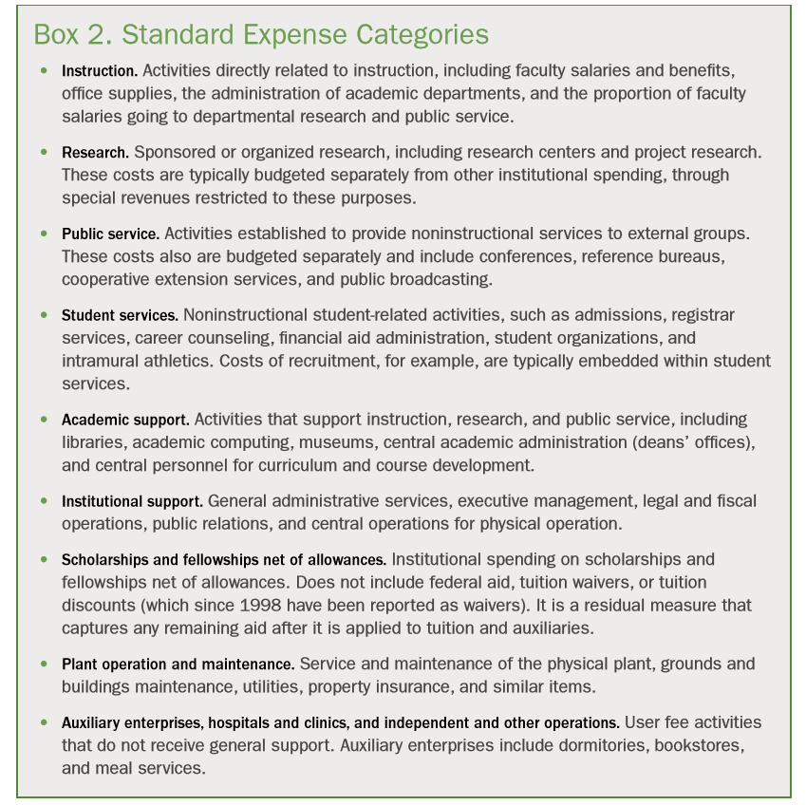

Slide 5

Other Expenditures (non-comprehensive)
Mental Health Services (increase in students with chronic/severe mental illness, “Coddling of American Mind” Analysis)
Diversity Professionals (Umich spent $14 million on diversity employees in 2017, including benefits and travel)
Litigation and Liability Expenditures (Geometric increases since 1970)
Notes:
https://www.forbes.com/sites/richardvedder/2018/07/23/diversity-and-other-administrative-monstrousities-the-case-of-the-university-of-michigan/#5a4a91cf68ec

Slide 6
Purpose
Describe general relationships between institutional revenue and instructional expenditure to inform more detailed analysis.

Slide 7
Findings
Spending
Institutions in the dataset received a median of $2,892.9 more per student in tuition and fees than they spent on per student instruction. The median ratio of spending to instructional expense was .75, meaning that for every dollar institutions brought in in tuition and fees, they spent about 75 cents on instruction.

Slide 8
Findings (Cont.)
Publics Spend More Than Privates
Public institutions spent noticeably more on instructional expense per tuition dollar than private institutions did, with the median public institution spending $1.33 on instruction for every dollar in tuition and fees, while the median private institution spent only $.59 for the same dollar. This is notable because, in general, it is private institutions that are noted for owning the largest endowments and therefore possessing the greatest resources to supplement tuition income for their students. As a group, only 8% of private institutions spent more than they received in tuition and fees, compared to 79% of public institutions. It is important to note that this is not necessarily a consequence of increased non-instructional spending on the part of private institutions, since state institutions tend to draw substantial resources from state governments to supplement their budgets which is unavailable to private institutions.

Slide 9
Findings (cont.)
Wealth Institutions Spend More on Instruction
In general, institutions that derived a lower proportion of revenue from tuition and fees spent more on instruction relative to tuition and fee revenue. Among institutions that derived less than 25% of their total revenue from tuition and fees, the median spending on instruction was $3,214 more than tuition revenue per student. However, in institutions that derived more than 75% of revenue from tuition and fees, median per student tuition and fee revenue exceeded revenue by $8,323. Whereas 93% institutions that derived less than 25% of their total revenue from tuition and fees spent more on instruction than they received in tuition revenue, no institutions that derived more than 75% of their revenue from tuition and fees spent more on instruction than they received in revenue.

